Slide 1
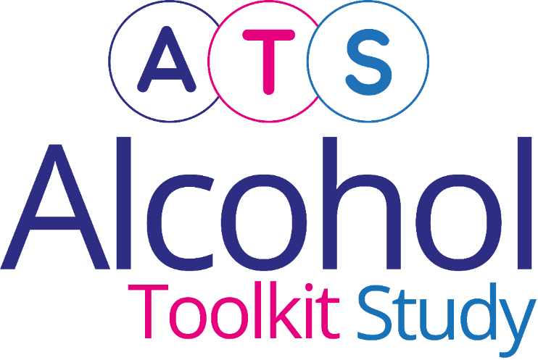



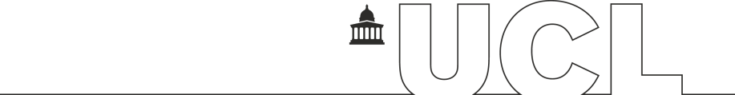
Latest trends on alcohol consumption in England from the Alcohol Toolkit Study
Vera Buss, Jamie Brown, Loren Kock
Last updated: 14th September 2026
www.alcoholinengland.info
jamie.brown@ucl.ac.uk

Slide 2

Prevalence of risky drinking (AUDIT-C ≥5) by social grade
Risky drinking operationalised as those scoring AUDIT-C ≥5
ABC1: Professional to clerical occupation; C2DE: Manual occupation

Slide 3
Prevalence of risky drinking (AUDIT-C ≥5) by gender
Risky drinking operationalised as those scoring AUDIT-C ≥5

Slide 4
Currently trying to restrict consumption
ABC1: Professional to clerical occupation; C2DE: Manual occupation.
Question: Are you currently trying to restrict your alcohol consumption e.g. by drinking less, choosing lower strength alcohol or using smaller glasses?

Slide 5
Motivation to cut down
ABC1: Professional to clerical occupation; C2DE: Manual occupation. Question: Which of the following best describes you? I REALLY want to cut down on drinking alcohol and intend to in the next month; I REALLY want to cut down on drinking alcohol and intend to in the next 3 months; I want to cut down on drinking alcohol and hope to soon; I REALLY want to cut down on drinking alcohol but I don't know when I will; I want to cut down on drinking alcohol but haven't thought about when; I think I should cut down on drinking alcohol but don't really want to; I don't want to cut down on drinking alcohol

Slide 6
GP advice to cut down
Question: In the last 12 months, has a doctor or other health worker within your GP surgery discussed your drinking? No; Yes, a doctor or other health worker within my GP surgery asked about my drinking; Yes, a doctor or other health worker within my GP surgery offered advice about cutting down on my drinking; Yes, a doctor or other health worker within my GP surgery offered help or support within the surgery to help me cut down; Yes, a doctor or other health worker within my GP surgery referred me to an alcohol service or advised me to seek specialist help. Follow-up question: You said a doctor or other health worker within your GP surgery has not discussed your drinking with you in the last 12 months. Please could you confirm which of the following statements applies to you: I have not seen a doctor or health worker within my GP surgery in last 12 months; I have seen a doctor or health worker within my GP surgery in the last 12 months but did not discuss my drinking

Slide 7
All past-year attempts to cut down or stop
ABC1: Professional to clerical occupation; C2DE: Manual occupation; Question: How many attempts to restrict your alcohol consumption have you made in the last 12 months (e.g. by drinking less, choosing lower strength alcohol or using smaller glasses)? Please include all attempts you have made in the last 12 months, whether or not they were successful, AND any attempt that you are currently making.

Slide 8
Serious past-year attempts to cut down or stop
ABC1: Professional to clerical occupation; C2DE: Manual occupation. Question: How many attempts to restrict your alcohol consumption have you made in the last 12 months (e.g. by drinking less, choosing lower strength alcohol or using smaller glasses)? Please include all attempts you have made in the last 12 months, whether or not they were successful, AND any attempt that you are currently making. Follow-up question: During your most recent attempt to restrict your alcohol consumption, was it a serious attempt to cut down on your drinking permanently?

Slide 9
Support in past-year attempts
Question: Which, if any, of the following did you use to try to help restrict your alcohol consumption during the most recent attempt? Evidence-based support defined as medication (e.g., acamprosate, disulfiram, or nalmefene) or behavioural support (any delivery mode)

Slide 10
Using low-alcohol/alcohol-free drinks in past-year attempts
Question: Which, if any, of the following did you use to try to help restrict your alcohol consumption during the most recent attempt? (answer options not mutually exclusive)

Slide 11
Triggers for past-year attempts
Question: Which of the following, if any, do you think contributed to you making the most recent attempt to restrict your alcohol consumption?

Slide 12
Prevalence of risky drinking (AUDIT ≥8)
Data not collected regularly on AUDIT items 4-10 from April 2022
Risky drinking operationalised as those scoring AUDIT ≥8
ABC1: Professional to clerical occupation; C2DE: Manual occupation

Slide 13
Methods
Data collected during monthly household survey beginning March 2014
Each month involves a new representative sample of ~ 1700 adults (16 and over)
Due to the pandemic:
  The March 2020 survey did not complete face-to-face collection at short notice and is missing
  To present trends, March is interpolated as the average of Feb and April
  From April 2020 to December 2021, surveys were conducted by telephone and among adults aged 18 and over. From January 2022 data collection resumed among those aged 16 and over.
  From April 2020 (switch to telephone), Ipsos started recording ~<5% cases as missing for social grade. To derive weight variable (which uses social grade), Ipsos assumed missing = social grade C1. To ensure analyses using weight and social grade reflect target weighed profile, social grade was recoded to reflect this assumption. Different assumptions for missing social grade cases were explored in a parallel telephone and face-to-face (with no missing social grade) wave, and this assumption found least distorting.
Between November 2020 and February 2022, ~0.8% of cases in England were incorrectly weighted 0. This has now been updated and some point estimates over this period have changed slightly (typically 1 d.p.) compared with earlier versions.
Since May 2022, some questions are not asked every month. Therefore, the 3-month moving average is calculated after imputing the average from the previous and the following for the missing value.
Methods described in open access: Beard, et al., 2015. 'Protocol for a national monthly survey of alcohol use in England with 6-month follow-up: ‘The Alcohol Toolkit Study’. BMC Public Health 15:230 – http://www.biomedcentral.com/1471-2458/15/230
Risky drinking measured using the Alcohol Use Disorders Identification Test – Consumption (AUDIT-C) https://cks.nice.org.uk/topics/alcohol-problem-drinking/diagnosis/how-to-screen/
For more info – including questionnaire - see www.alcoholinengland.info

